Slide 1
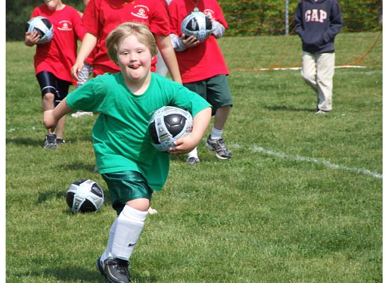
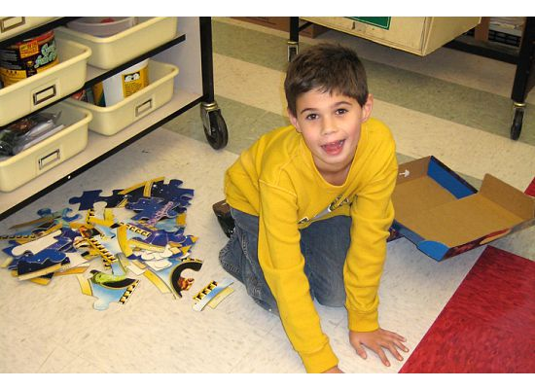
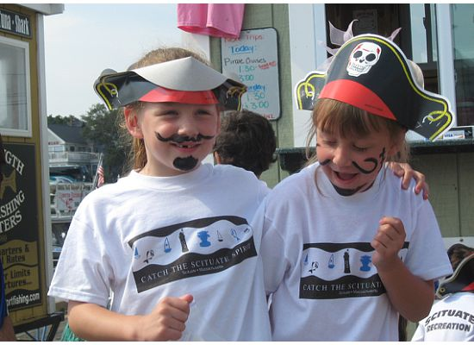
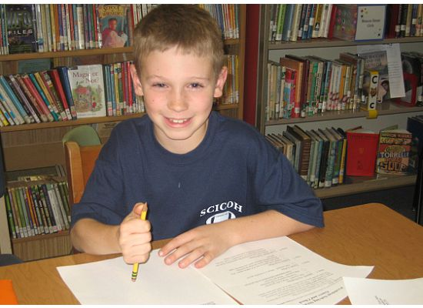
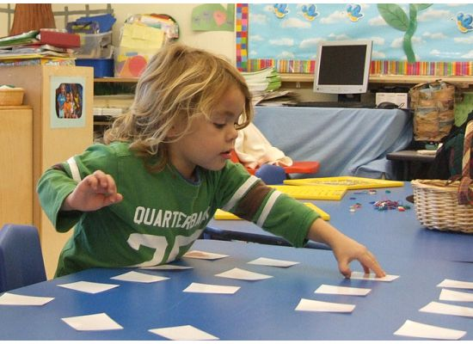
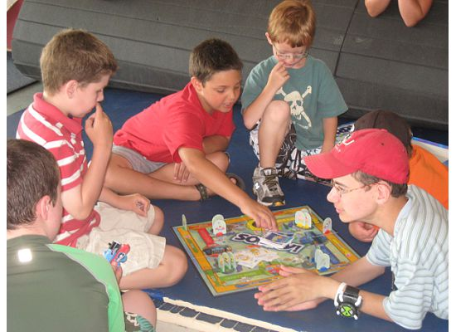
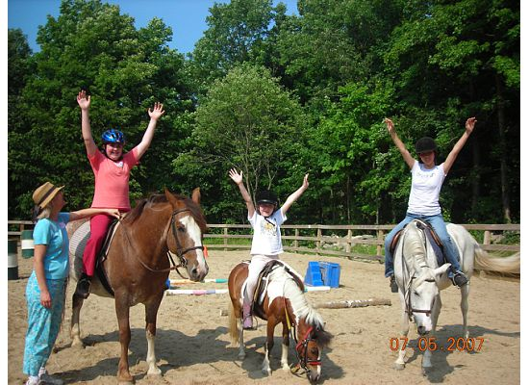
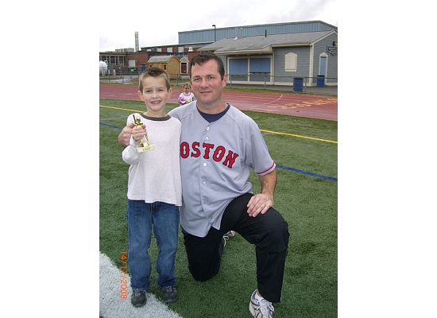
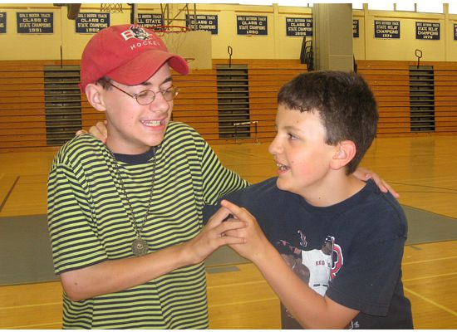
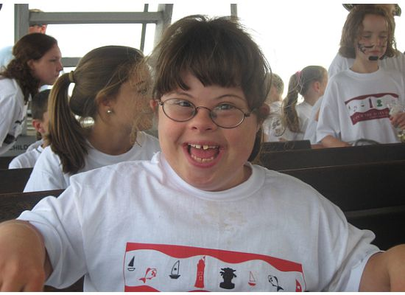
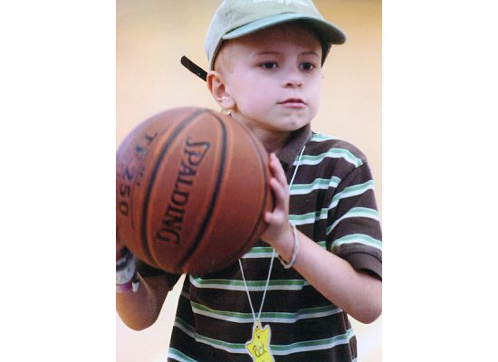
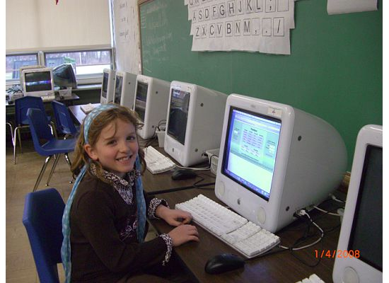
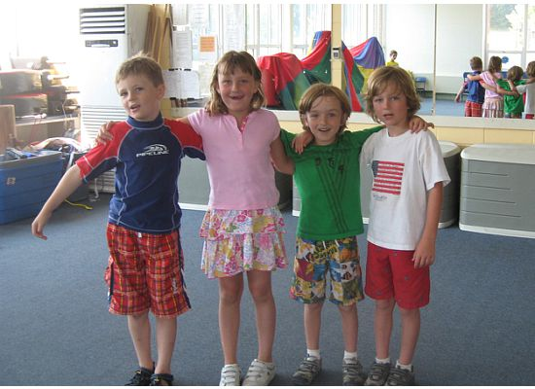
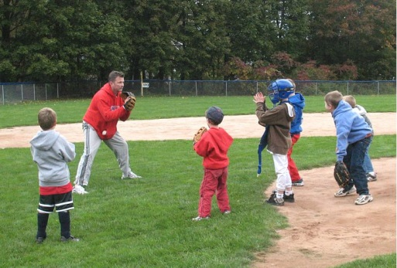
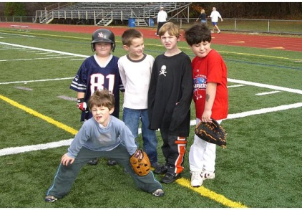
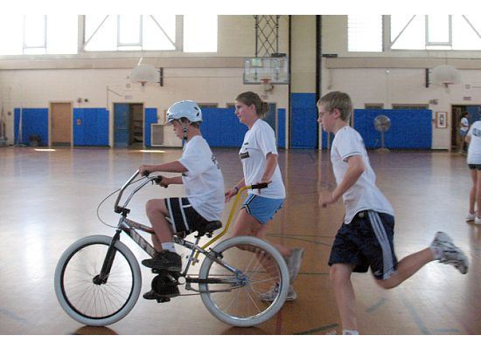
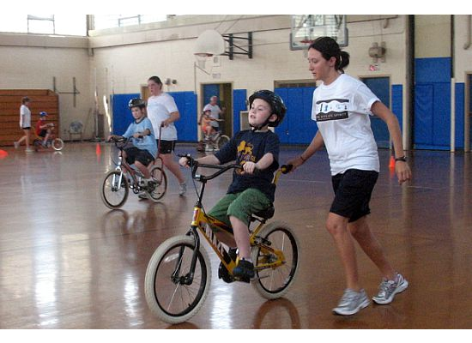
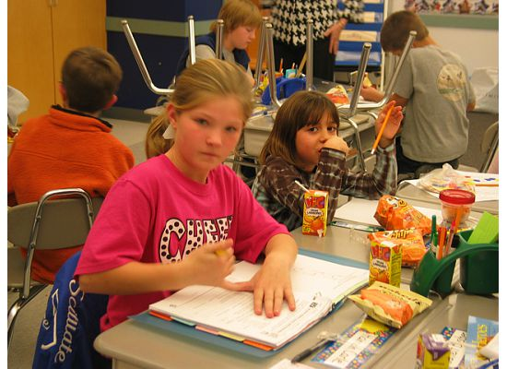
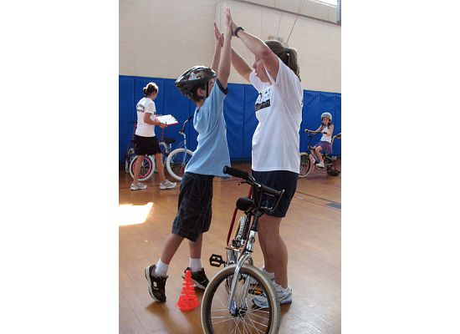
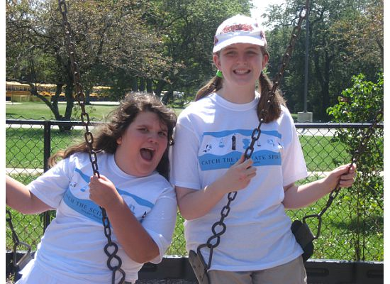
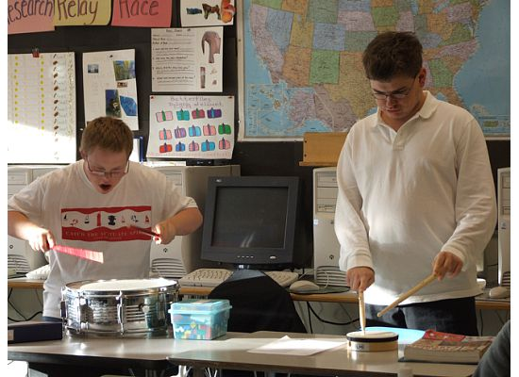
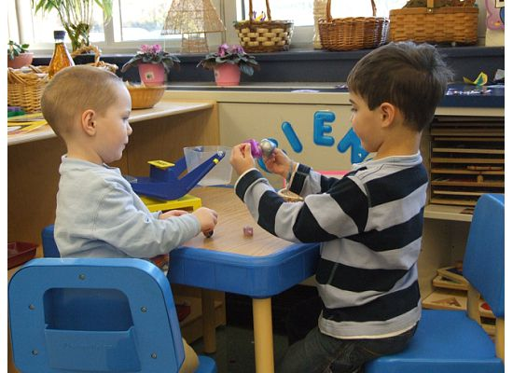

Slide 2
Our Mission:
To raise funds to provide high quality and affordable programming, training and resources that will benefit children with special needs (ages 3-22), their families and educators throughout South Shore Massachusetts. CORSE has designed an innovative model within a blended framework of integrated and specialized social, academic, recreation, therapeutic and work-skills development programs so children with special needs can reach their full potential. Our variety of programs are staffed appropriately through customized staffing ratios and special education expertise so ALL children, those with and without special needs, can successfully participate together within their community.

Slide 3
Reality: Our special education population is on the rise.
Tremendous national attention, but much of spotlight is on researching the cause
Town, state and federal budgets do not have sufficient resources to provide necessary services and skills to these children now
C.O.R.S.E. model can be adapted to communities throughout the nation as a model of how parents, educators & community members can collaborate to better serve this population

Slide 4
C.O.R.S.E. allocates funds for a wide range of supplemental resources that benefit children, parents and educators:
Integrated Social Development and Academic Programs
Recreation programs: Basketball, Running, Karate
Summer Programs: All Stars Summer Adventures, Therapeutic Horseback Riding, Maritime Adventures, iCan Bike, Skateboarding
Therapeutic Programs: Music Therapy, Yoga
Work Skills Development Programs
“Let's Go” Community Events: Movies, Dining out, Bowling & More
Peer Mentoring
Sibshops
Professional Development Programs for Educators and Staff
Educational Programs and Resource Materials for Parents
Equipment and Technology Supports

Slide 5
FACT: The special needs population requires costly, more intensive services; it is the responsibility of parents and schools to find ways to provide these services.
Through innovative collaboration with Scituate Public Schools, Scituate Recreation and other community organizations, we are able to:
Fundraise for needed supplemental resources
Develop customized programs to best meet children’s needs
Offer programs that are more affordable than costly private

Slide 6
Our innovative programming and resources:
Help integrate children with special needs and their families into their community, bringing inclusion opportunities to all, those with and without special needs
Build student confidence and engagement in social, academic, recreation, therapeutic and work skills development programs
Strengthen parent and educator skills
Provide these opportunities at an affordable rate despite the program’s instructor expertise and high staffing ratios

Slide 7
Volunteer board and membership
Parents of children with special needs
Parents with only typically developing children
Staff from Scituate Public Schools & Scituate Recreation Department
Community members interested in supporting our efforts

Slide 8
Recognition
2020 March WBZ Cares Featured Charity
2016 South Shore Conservatory Community Partnership Award
2016 Scituate Recreation Community Spirit Award
2016 FOX25 Hometown Team Award
2016 Boston Red Sox Disability Awareness Day First Pitch Honor with Paul Wahlberg
2015 Myra Kraft Community MVP Award second prize winner from the New England Patriots Foundation
2014 primary speaker at the first Flutie Foundation Partner Summit
2011 Massachusetts Recreation & Park Association Program Outreach Award
2009 “Citizen of the Year” in Scituate
2008 Massachusetts Community Partnership Award from the Federation for Children with Special Needs

Slide 9
Serves children with special needs, ages 3-22
Annually runs >50 programs with >850 student registrations
Current statistics (February 2006-August 2020)
Membership: 4,000+
Programming/Resources Provided: >$1,388,000
Programs: 662
Student Registrations: 9,805
Student Mentors: 1,228
Administrative Overhead 4.9%

Slide 10
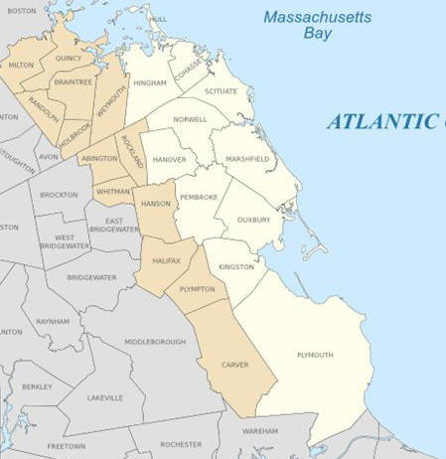
Hull
Milton
Cohasset
Braintree
Hingham
Scituate
Weymouth
Children come from communities throughout the South Shore, Framingham, Easton, Cape Cod and as far away as New Hampshire, North Carolina and Minnesota
Norwell
Abington
Hanover
Marshfield
Hanson
Pembroke
East Bridgewater
Duxbury
Kingston

Slide 11
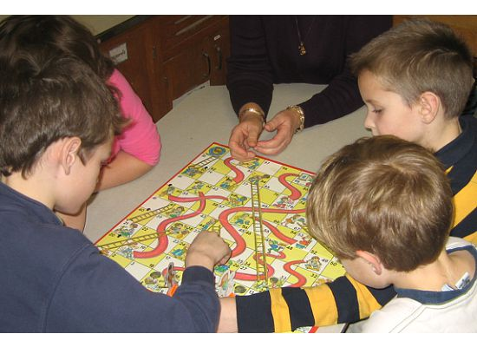
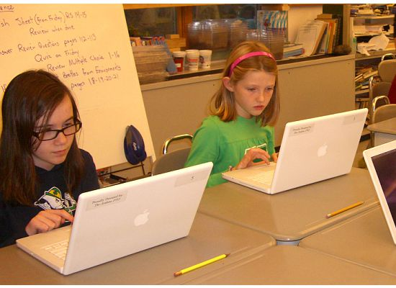
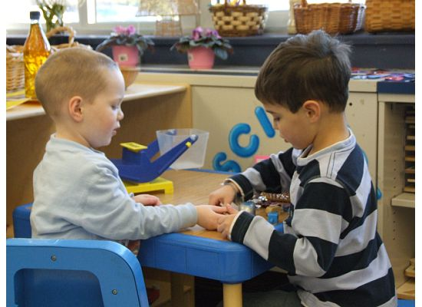
Social Development Programs: Provide opportunities for children to learn lifelong social skills in communication, cooperation & self-confidence Academic Year & Summer
PreK Circle of Friends
PreK Sunshine Adventurers
Grades K-2 Integrated Best
Buddies with field trips
Grades 3-5 Integrated Best
Buddies with field trips
Middle School Integrated Best
Buddies with field trips
HS Integrated Best Buddies
with field trips
Peer Mentoring

Slide 12
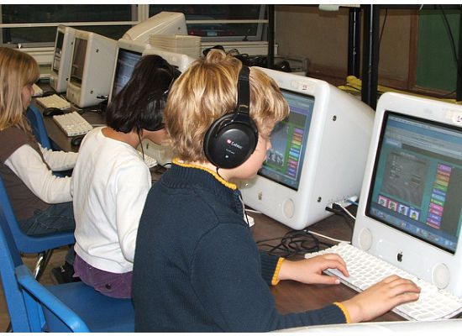
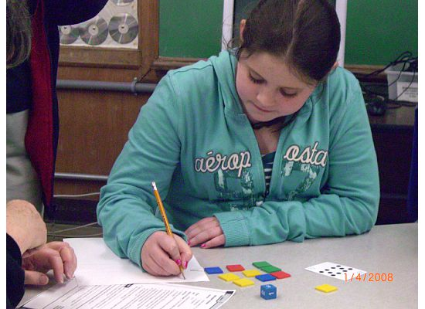
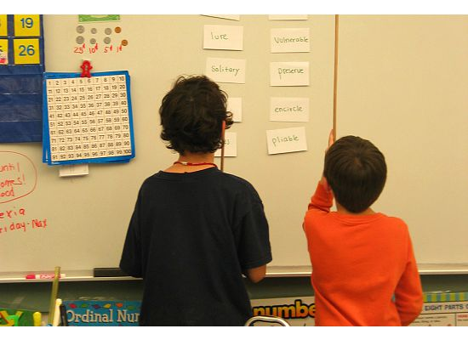
Academic Support Programs: Provide grade level appropriate skill development in math, reading, writing and study skills, Grades 3-12
Academic Year & Summer
Math
Reading and Writing
Homework & Executive
Functioning Skill-Building
Strategies

Slide 13
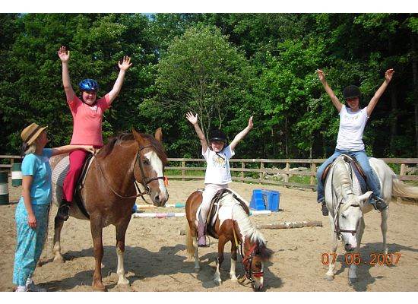
Recreation Programs: Teach children how to access their own creativity, develop physical skills, and play in a constructive and appropriate manner, which increases self-esteem and self confidence.
All Stars Sports Programs Basketball, Running, Karate
All Stars Camps: (Gr 1-4) & (Gr 5-8)
Therapeutic Horseback Riding
iCan Bike Camp
Maritime Adventures through Access Sport
Skateboarding

Slide 14
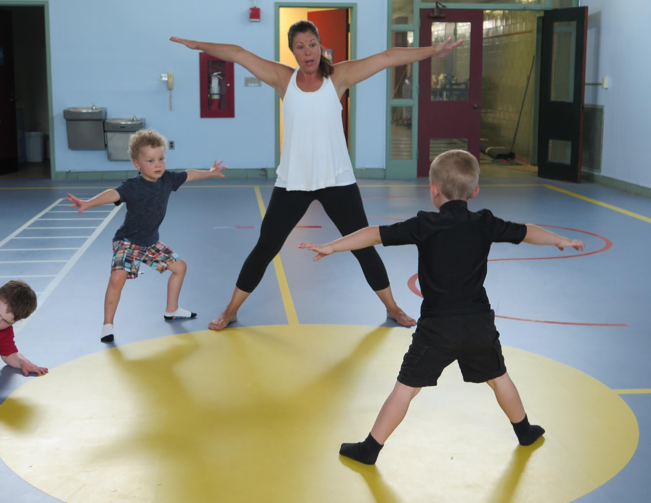
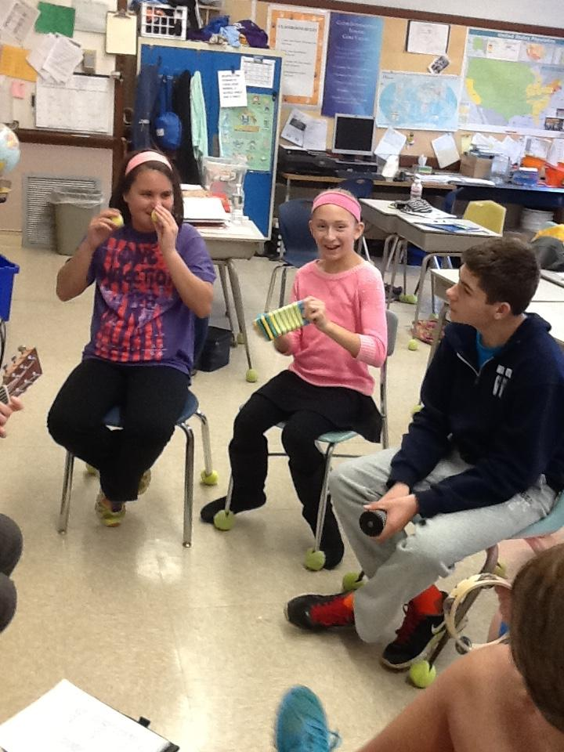
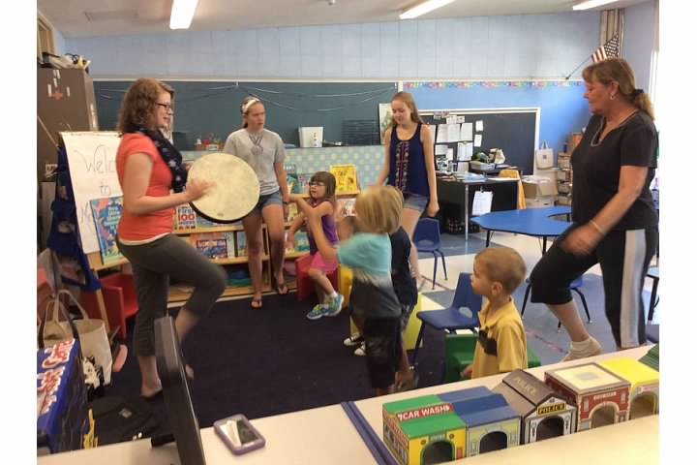
Therapeutic Programs PreK-HS:
Music Therapy
Yoga

Slide 15
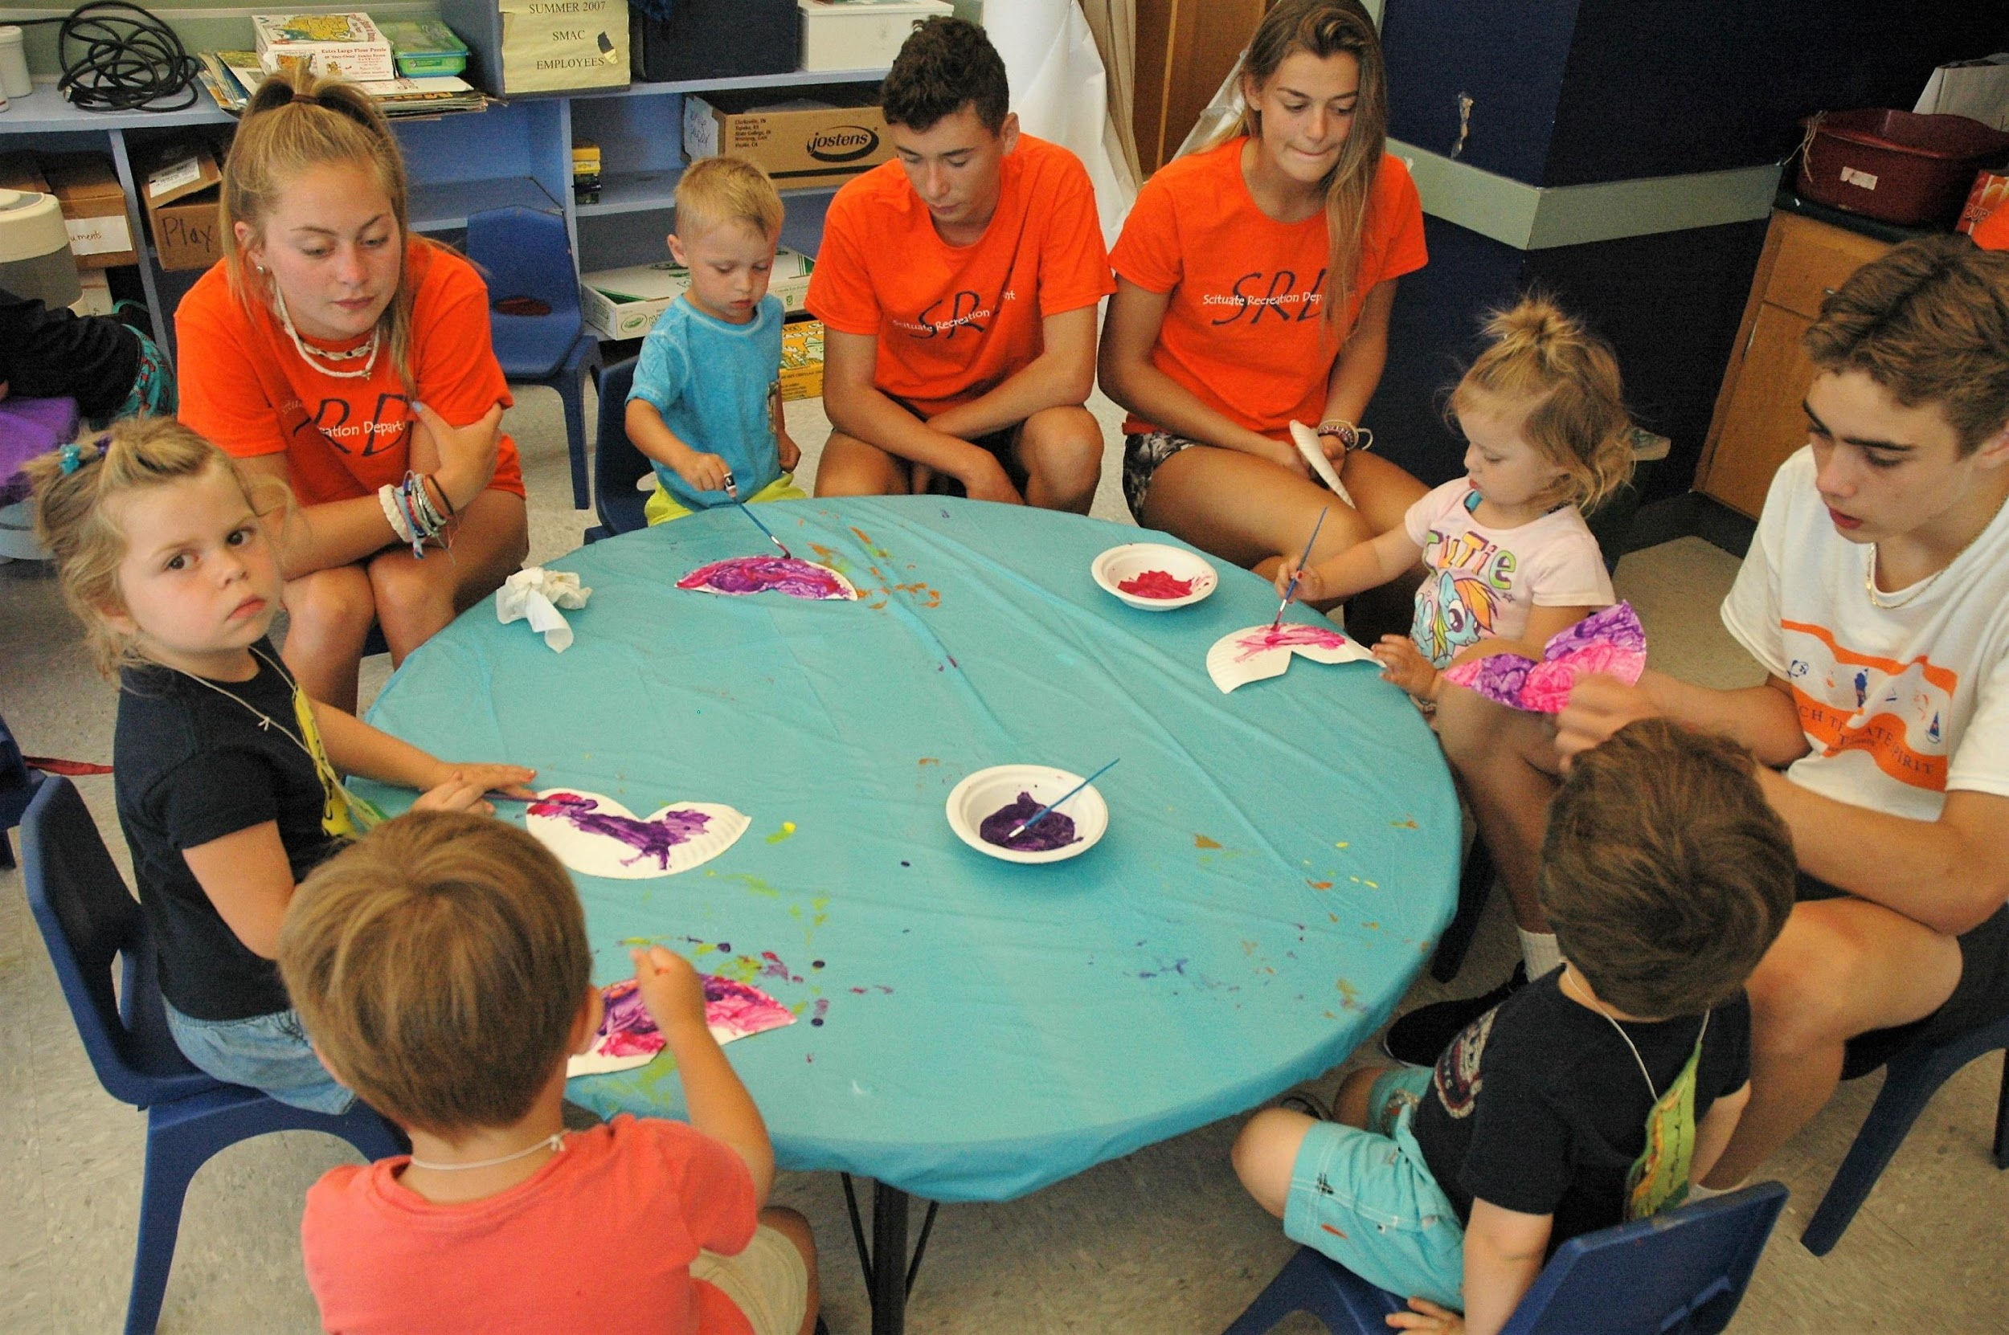
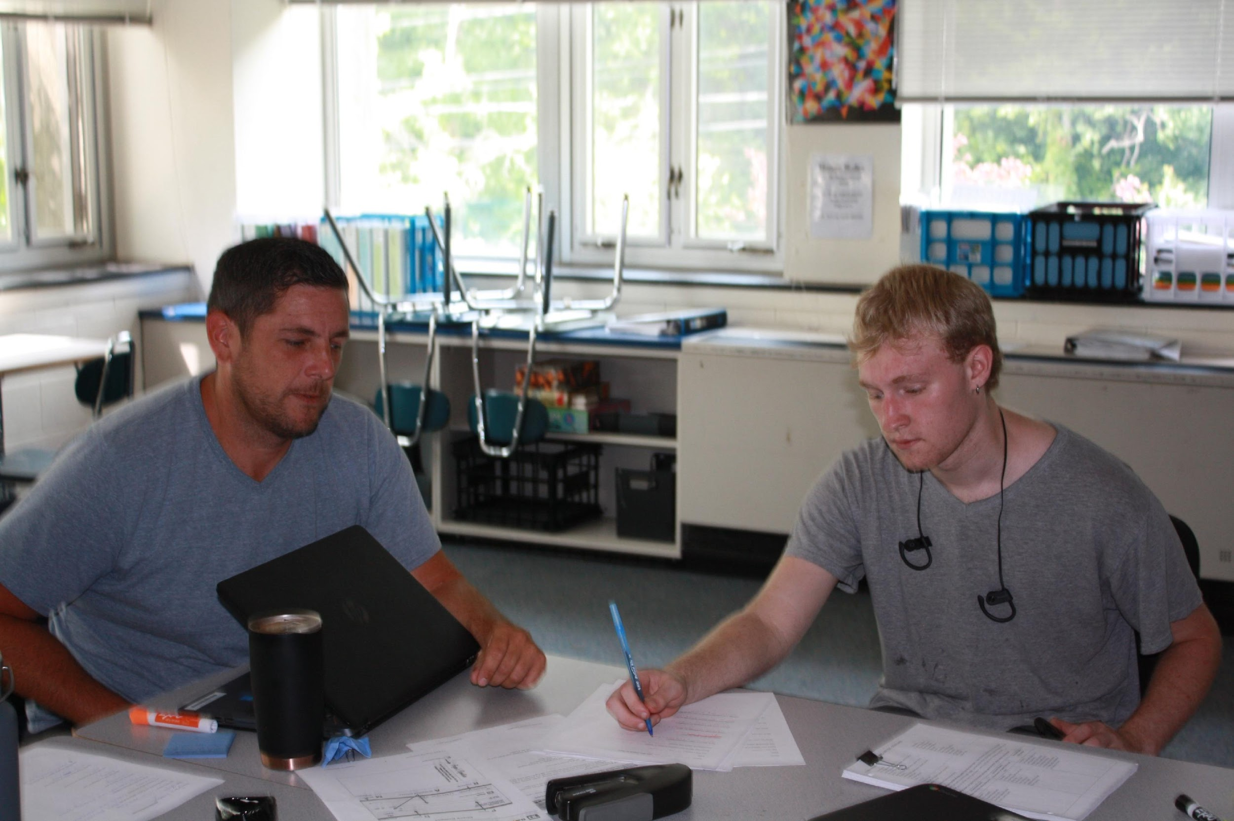
Student Work-Skills Development :
Recreation Volunteer Training Program
Recreation Counselor Summer Internships
Community Organization Summer Internships
iExcel Summer Stipends

Slide 16
As Timmy’s legal guardian, one of the biggest issues was finding affordable and accessible after-school activities designed for students with special needs. Thanks to CORSE, my grandson has had the opportunity to try new things and to benefit from the skilled instructors and specialized activities designed for fragile learners like him.
Therapists, doctors, and educators are always quick to point out to me, “how far Timmy has come.” A large part of his progress is due to his experiences in CORSE programs which have enabled Timmy to learn the social pragmatics that are so difficult for a child with autism.
Timmy is learning how to be a friend and how to have a friend. What experience could be more valuable for a child?
--Timmy’s Grandmother

Slide 17
“Not only can 30 children now ride a two-wheeler who could not a week before, their self-confidence in themselves visibly beamed during that week. They can now engage in a typical children’s activity that is so important to childhood socialization and development.
Parents watched from the sidelines with tears in their eyes and immense smiles on their faces, demonstrating the overwhelming pride and joy they felt for their kids.“
--Parent

Slide 18
What did I like most about the program?
How it makes my daughter Maggie feel about herself.
--Maggie’s Mom

Slide 19
“Any program which has been offered through CORSE has been incredible. My experience with CORSE has shown me that they will only hold programs with the proper staff, the proper support and the desire for the children to learn new skills while having fun in the process. “
--Parent

Slide 20
For more information:
Visit our website: www.corsefoundation.org
Contact us: corsefoundation@comcast.net
Updated 9/20/20

Slide 21
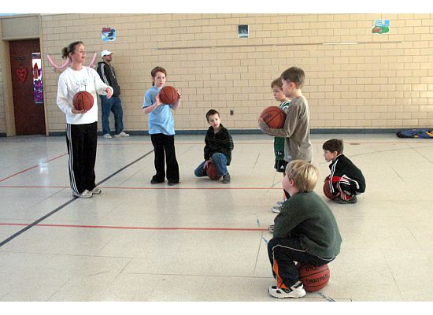
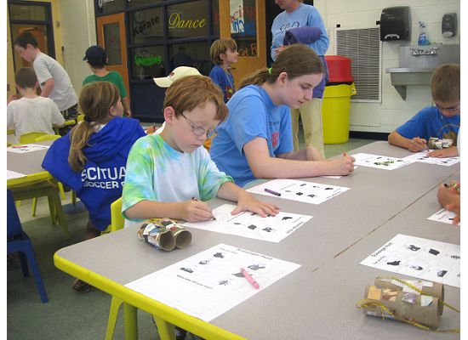
Your generous donation to the C.O.R.S.E. Foundation will make a profound difference in the lives of children, parents and teachers.
Thank you!

